Slide 1
Artificial Intelligence
Genetic Algorithm for Learning
ADF

Slide 2
A Little about Regression

Slide 3
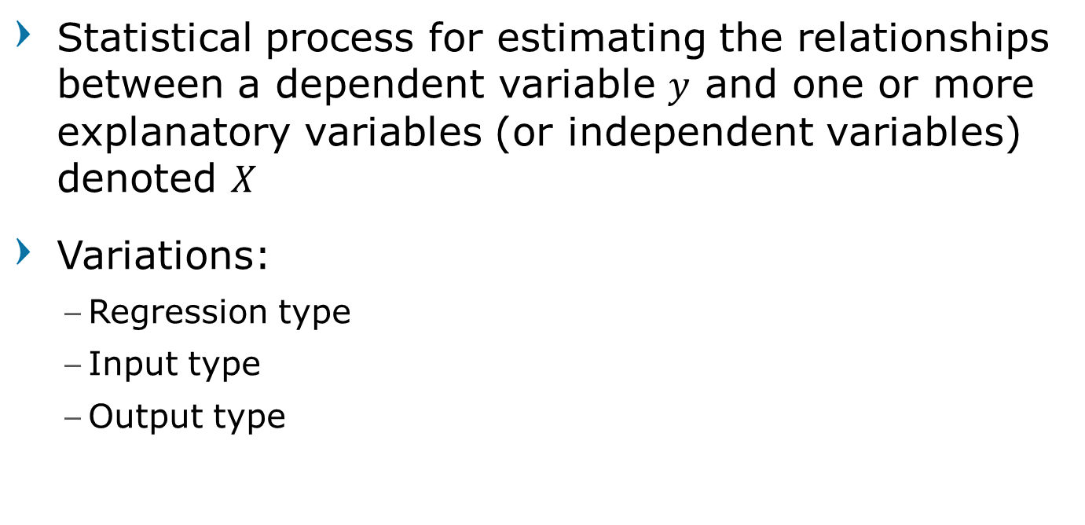
Regression Analysis
Statistical process for estimating the relationships between a dependent variable $y$ and one or more explanatory variables (or independent variables) denoted $X$
Variations:
Regression type
Input type
Output type
Machine Learning

Slide 4
Regression Analysis
Regression Type:
Linear
Non Linear
Input Type
Univariate
Multivariate
Output Type
Regression (output value)
Classification (output class)
Machine Learning

Slide 5
Linear Regression
linear approach for modeling the relationship between a scalar dependent
The goal is to make quantitative (real valued) predictions on the basis of a (vector of) features or attributes
Machine Learning

Slide 6

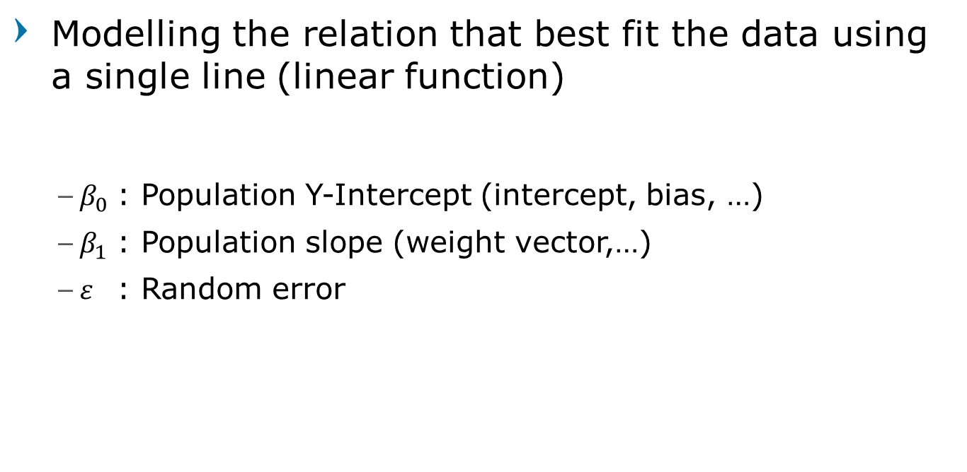
Linear Regression
Modelling the relation that best fit the data using a single line (linear function)
$β_{0}$ : Population Y-Intercept (intercept, bias, …)
$β_{1}$ : Population slope (weight vector,…)
$ε$ : Random error
$$y=β_{0}+β_{1}x+ε$$
(1)
Machine Learning

Slide 7
Nonlinear Model
Linear regression can also be used to fit models which are nonlinear functions of the input
Nonlinear models by transforming the input
Example: For fitting a degree 5 polynomial
$$y_{i}=f\left(x_{i}\right)=w_{0}+w_{1}x_{i}+w_{2}x_{i}^{2}+w_{3}x_{i}^{3}+w_{4}x_{i}^{4}+w_{5}x_{i}^{5}$$
Machine Learning

Slide 8
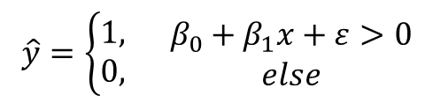

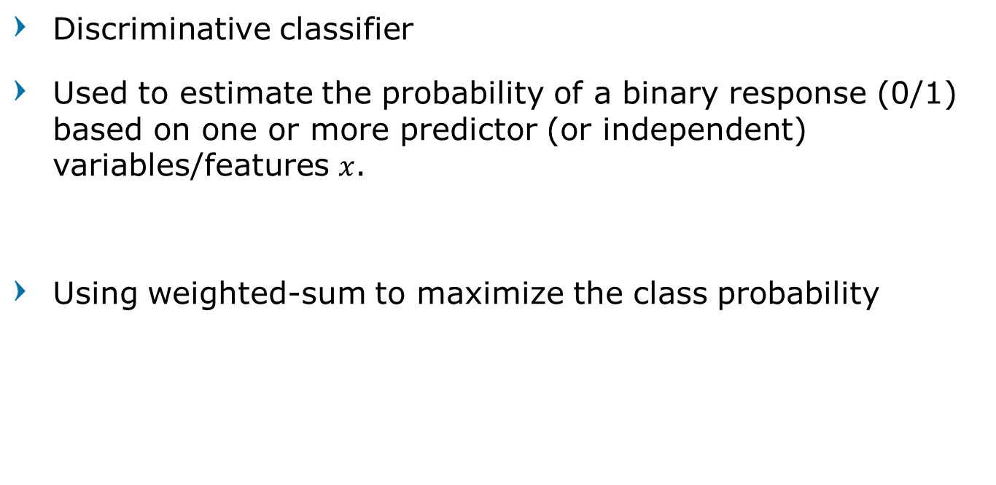
Logistic Regression
Discriminative classifier
Used to estimate the probability of a binary response (0/1) based on one or more predictor (or independent) variables/features $x$.
Using weighted-sum to maximize the class probability
$$P\left(y=1 | x\right)=\hat{y}$$

Slide 9
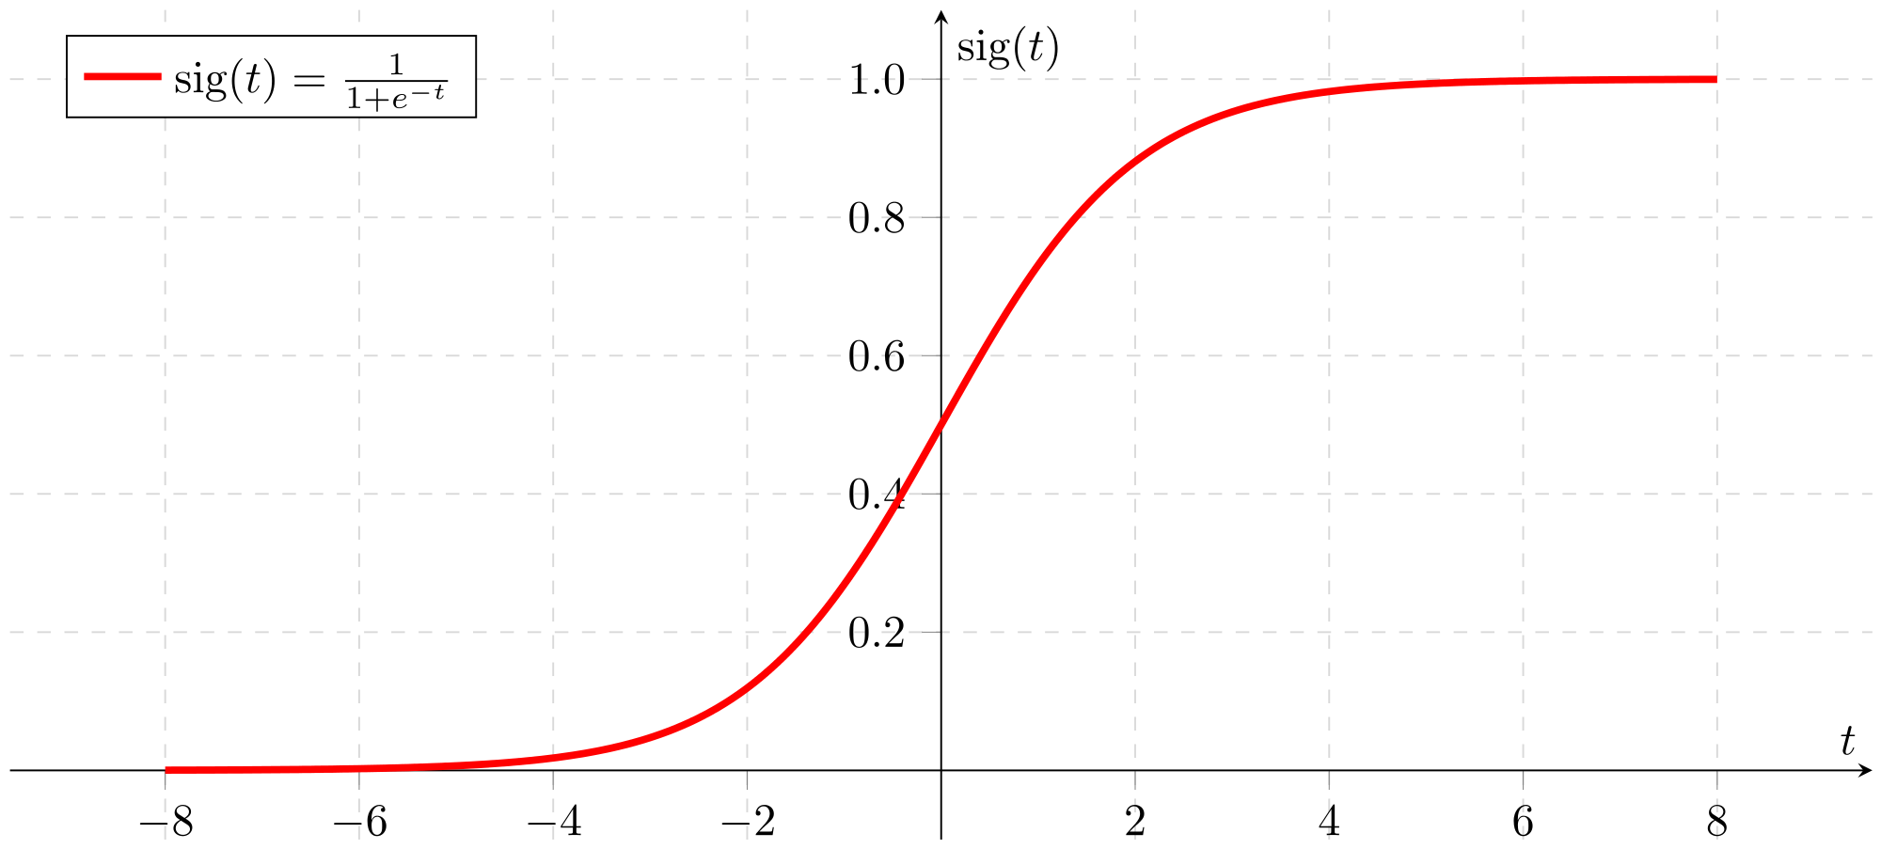






Logistic Regression
Logistic function $σ(t)$
$\hat{y}=P\left(y=1 | x\right) , 0≤\hat{y}≤1$
$t=β_{0}+β_{1}x$
$t=β_{0}+β_{1}x_{1}+β_{2}x_{2}$ $+…+β_{n}x_{n}$
$\hat{y}=σ\left(t\right)$
$$σ\left(t\right)=\frac{1}{1+e^{−t}}$$
Objective: finding the $β$ parameters that best fit the equation

Slide 10

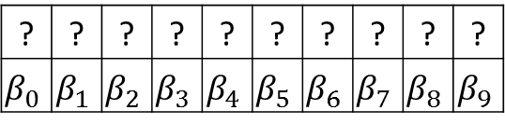

Logistic Regression
1 | 1 | 1
1 | 0 | 0
1 | 1 | 1
Class = 1
1 | 1 | 1 | 1 | 0 | 0 | 1 | 1 | 1
Maximize $σ(t)$
? | ? | ? | ? | ? | ? | ? | ? | ? | ?
$$β_{0}$$ | $$β_{1}$$ | $$β_{2}$$ | $$β_{3}$$ | $$β_{4}$$ | $$β_{5}$$ | $$β_{6}$$ | $$β_{7}$$ | $$β_{8}$$ | $$β_{9}$$
Minimize $σ(t)$
1 | 1 | 0
1 | 0 | 1
1 | 1 | 0
Class = 0
1 | 1 | 0 | 1 | 0 | 1 | 1 | 1 | 0

Slide 11
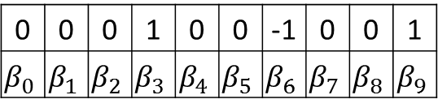


Logistic Regression
1 | 1 | 1
1 | 0 | 0
1 | 1 | 1
Class = 1
$$=\frac{1}{1+e^{−2}}=0.9$$
1 | 1 | 1 | 1 | 0 | 0 | 1 | 1 | 1
? | ? | ? | ? | ? | ? | ? | ? | ? | ?
$$β_{0}$$ | $$β_{1}$$ | $$β_{2}$$ | $$β_{3}$$ | $$β_{4}$$ | $$β_{5}$$ | $$β_{6}$$ | $$β_{7}$$ | $$β_{8}$$ | $$β_{9}$$
0 | 0 | 0 | 1 | 0 | 0 | -1 | 0 | 0 | 1
$$β_{0}$$ | $$β_{1}$$ | $$β_{2}$$ | $$β_{3}$$ | $$β_{4}$$ | $$β_{5}$$ | $$β_{6}$$ | $$β_{7}$$ | $$β_{8}$$ | $$β_{9}$$
1 | 1 | 0
1 | 0 | 1
1 | 1 | 0
Class = 0
$$=\frac{1}{1+e^{1}} =0.3$$
1 | 1 | 0 | 1 | 0 | 1 | 1 | 1 | 0

Slide 12
Find Parameter $β$
Learn to find the parameter from data
Incrementally update the parameters until it find the best fit
Machine Learning Algorithms
You’ll learn more about these next semester

Slide 13
Find Parameter $β$
Search the parameter
Blind Search ?
The time it takes will be too long
Random Search ?
Might work if you’re in luck
Using Genetic Algorithm
Fast and controlled

Slide 14
Genetic Algorithm to Learn Linear Regression

Slide 15
Genetic Algorithm
Chromosome length
According to the number of parameters sought
Encode/Decode
Binary, Integer, Real
Crossover and Mutation
Choose accordingly

Slide 16
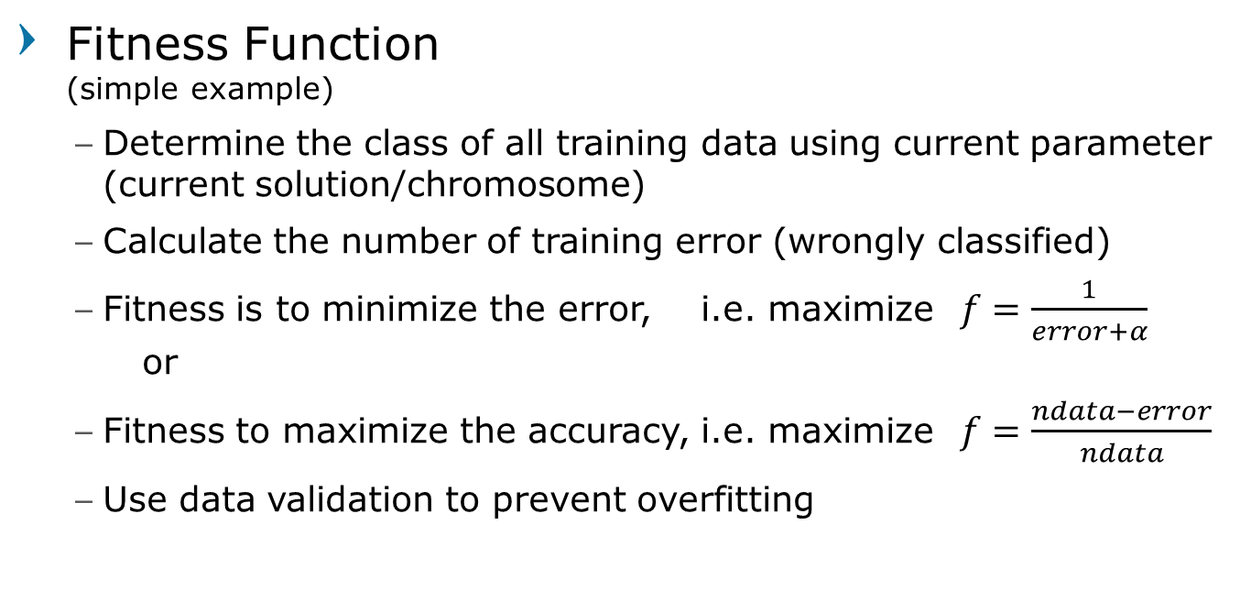
Genetic Algorithm
Fitness Function (simple example)
Determine the class of all training data using current parameter (current solution/chromosome)
Calculate the number of training error (wrongly classified)
Fitness is to minimize the error, i.e. maximize $f=\frac{1}{error+α}$ or
Fitness to maximize the accuracy, i.e. maximize $f=\frac{ndata−error}{ndata}$
Use data validation to prevent overfitting

Slide 17
Genetic Algorithm
Data Train
Calculate Error
generation = maxGen ?
bestFitness > th ?
START
Initiate Random Population
Fitness Evaluation
STOP
Population
yes
generation=t
no
generation=1
Survivor Selection
Parent Selection
Mutation
Offspring
Crossover

Slide 18
Genetic Algorithm to Learn Decision Tree

Slide 19
Example: Employee Recruitment Data
Applicants | GPA | Psychology | Interview
P1 | Good | Strong | Proper
P2 | Good | Moderate | Proper
P3 | Good | Moderate | Unsuitable
P4 | Good | Weak | Unsuitable
P5 | Average | Strong | Proper
P6 | Average | Moderate | Proper
P7 | Average | Moderate | Unsuitable
P8 | Average | Weak | Unsuitable
P9 | Poor | Strong | Proper
P10 | Poor | Moderate | Unsuitable
P11 | Poor | Weak | Proper
Accepted
Yes
Yes
Yes
No
Yes
Yes
Yes
No
Yes
No
Yes

Slide 20
Convert Rule into Binary String
Convert according to number of attributes
GPA → 3 bit
Psychology → 3 bit
Interview → 2 bit
Accepted → 1 bit
Total string for each rule = 9 bit (9 gen rule)

Slide 21
Convert Rule into Binary String
if GPA='Good' and Psychology='Moderate' and Interview='Proper' then Accepted='Yes'
GPA |  |  | Psychology |  |  | Interview |  | Accept
1 | 0 | 0 | 0 | 1 | 0 | 1 | 0 | 1
if GPA=‘Average’ and Psychology='Moderate' and Interview=‘Unsuitable’ then Accepted='Yes'
GPA |  |  | Psychology |  |  | Interview |  | Accept
0 | 1 | 0 | 0 | 1 | 0 | 0 | 1 | 1
If (Psychology='Moderate’ or Psychology=‘Weak’ ) and Interview=‘Unsuitable’ then Accepted=‘No’
GPA |  |  | Psychology |  |  | Interview |  | Accept
1 | 1 | 1 | 0 | 1 | 1 | 0 | 1 | 0
If Interview=‘Proper’ then Accepted='Yes'
GPA |  |  | Psychology |  |  | Interview |  | Accept
1 | 1 | 1 | 1 | 1 | 1 | 1 | 0 | 1

Slide 22
Convert Rule into Binary String
Solution may consist of more than one rule
i.e. more than 9 gen
9 bit |  |  |  |  |  |  |  |  | 9 bit |  |  |  |  |  |  |  |  | 9 bit
1 | 1 | 1 | 1 | 1 | 1 | 1 | 0 | 1 | 1 | 0 | 0 | 0 | 1 | 0 | 0 | 1 | 1 | 0 | 1 | 0 | 0 | 1 | 0 | 0 | 1 | 1
Rule 1 |  |  |  |  |  |  |  |  | Rule 2 |  |  |  |  |  |  |  |  | Rule 3
If Interview=‘Proper’ then Accepted='Yes’ If GPA=‘Good’ and Psychology='Moderate’ and Interview=‘Unsuitable’ then Accepted='Yes’’ If GPA=‘Average’ and Psychology='Moderate’ and Interview=‘Unsuitable’ then Accepted='Yes’'

Slide 23
Genetic Algorithm
Chromosome length
Dynamic Chromosome
Undetermined, (Mod 9)
Encode/Decode
Binary Encoding
Fitness Function
Maximize the accuracy

Slide 24
Genetic Algorithm
Mutation
Bit swap
Crossover
Modified 2-point crossover:
Select 2 parents,
Randomly select 2 point in range [0, length parent 1]
Generate possible crossover point for parent 2 from crossover point parent 1
Randomly select a pair of possible crossover point
Perform crossover

Slide 25
Example Crossover 1
1 | 0 | 0 | 1 | 1 | 1 | 1 | 1 | 1 | 1 | 0 | 0 | 0 | 1 | 0 | 0 | 1 | 1
Rule 1 |  |  |  |  |  |  |  |  | Rule 2
Randomly select 2 point
p1 = {1,12}
Generate possible crossover point for parent 2
p2 = {1,12}
p2 = {1,3}
p2 = {10,12}
1 | 1 | 1 | 1 | 1 | 1 | 1 | 0 | 1 | 1 | 0 | 0 | 1 | 0 | 0 | 1 | 0 | 1
Rule 1 |  |  |  |  |  |  |  |  | Rule 2
p1 = {21-1} = 11 gen
gap = 11 mod 9 = 2 gen
p2 = 1, 1 + 11 = { 1, 12} = ok
p2 = 1, 1 + 2 = { 1, 3} = ok
p2 = 12 – 11, 12 = { 1, 12} = not ok
p2 = 12 – 2, 12 = {10, 12} = ok

Slide 26
Example Crossover 1
1 | 0 | 0 | 1 | 1 | 1 | 1 | 1 | 1 | 1 | 0 | 0 | 0 | 1 | 0 | 0 | 1 | 1
Rule 1 |  |  |  |  |  |  |  |  | Rule 2
Randomly select 2 point
p = {1,12}
Generate possible crossover point for parent 2
p = {1,12}
p = {1,3}
p = {10,12}
1 | 0 | 0 | 1 | 1 | 1 | 1 | 1 | 1 | 1 | 0 | 0 | 0 | 1 | 0 | 0 | 1 | 1
Rule 1 |  |  |  |  |  |  |  |  | Rule 2
Possible crossover:
Filled with 11 gens from parent 2
Filled with 2 gens from 1st rule of parent 2
Filled with 2 gens from 2nd rule of parent 2
Randomly select from possible crossover choices
1 | 1 | 1 | 1 | 1 | 1 | 1 | 0 | 1 | 1 | 0 | 0 | 1 | 0 | 0 | 1 | 0 | 1
Rule 1 |  |  |  |  |  |  |  |  | Rule 2

Slide 27
Example Crossover 1
1 | 1 | 1 | 1 | 1 | 1 | 1 | 0 | 1 | 1 | 0 | 0 | 0 | 1 | 0 | 0 | 1 | 1
Rule 1 |  |  |  |  |  |  |  |  | Rule 2
If p = {1,12} was selected
1 | 0 | 0 | 1 | 1 | 1 | 1 | 1 | 1 | 1 | 0 | 0 | 1 | 0 | 0 | 1 | 0 | 1
Rule 1 |  |  |  |  |  |  |  |  | Rule 2
1 | 1 | 1 | 1 | 1 | 1 | 1 | 1 | 1 | 1 | 0 | 0 | 0 | 1 | 0 | 0 | 1 | 1
Rule 1 |  |  |  |  |  |  |  |  | Rule 2
If p = {1,3} was selected
1 | 0 | 0 | 1 | 1 | 1 | 1 | 1 | 1 | 1 | 0 | 0 | 1 | 1 | 1 | 1 | 0 | 1 | 1 | 0 | 0 | 1 | 0 | 0 | 1 | 0 | 1
Rule 1 |  |  |  |  |  |  |  |  | Rule 2 |  |  |  |  |  |  |  |  | Rule 3
1 | 0 | 0 | 1 | 1 | 1 | 1 | 1 | 1 | 1 | 0 | 0 | 0 | 1 | 0 | 0 | 1 | 1
Rule 1 |  |  |  |  |  |  |  |  | Rule 2
If p = {10,12} was selected
1 | 1 | 1 | 1 | 1 | 1 | 1 | 0 | 1 | 1 | 0 | 0 | 1 | 1 | 1 | 1 | 1 | 1 | 1 | 0 | 0 | 1 | 0 | 0 | 1 | 0 | 1
Rule 1 |  |  |  |  |  |  |  |  | Rule 2 |  |  |  |  |  |  |  |  | Rule 3

Slide 28
Example Crossover 2
1 | 0 | 0 | 1 | 1 | 1 | 1 | 1 | 1 | 1 | 0 | 0 | 0 | 1 | 0 | 0 | 1 | 1
Rule 1 |  |  |  |  |  |  |  |  | Rule 2
Randomly select 2 point
p1 = {5,11}
Generate possible crossover point for parent 2
p2 = {5,11}
1 | 1 | 1 | 1 | 1 | 1 | 1 | 0 | 1 | 1 | 0 | 0 | 1 | 0 | 0 | 1 | 0 | 1
Rule 1 |  |  |  |  |  |  |  |  | Rule 2
p1 = 11 – 5 = 6 gen
gap = 6 mod 9 = 6 gen
p2 = 5, 5 + 6 = { 5, 11} = ok
p2 = 5, 5 + 6 = { 5, 11} = not ok
p2 = 11 – 6, 11 = { 5, 11} = not ok
p2 = 11 – 6, 11 = { 5, 11} = not ok

Slide 29
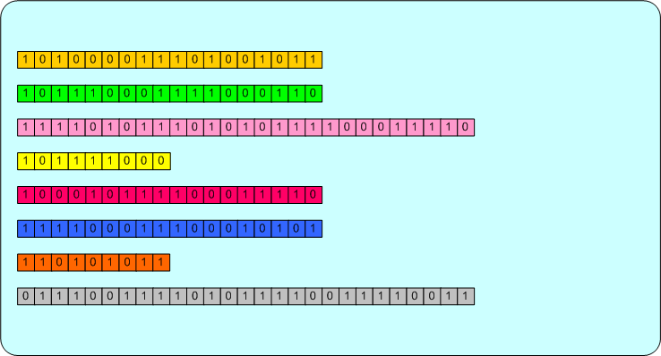
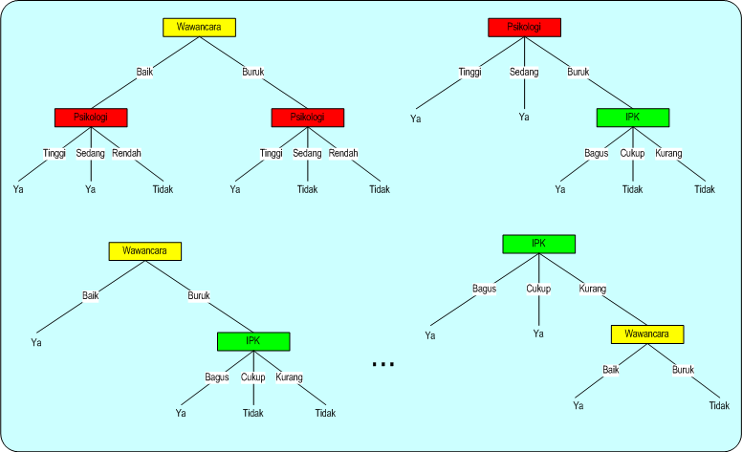
1st Generation

Slide 30
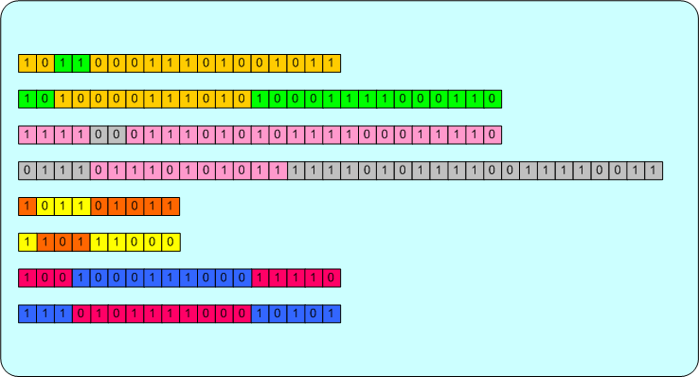
2nd Generation

Slide 31
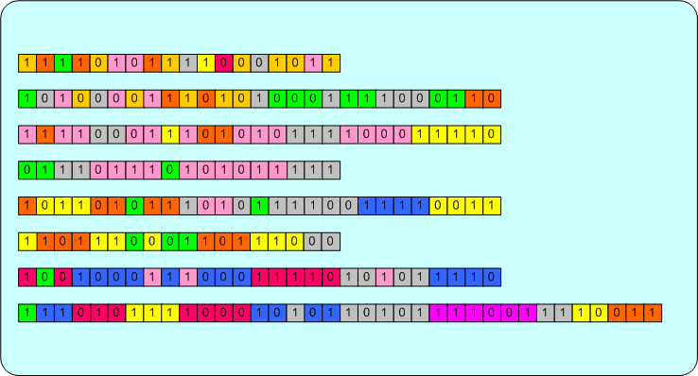
10th Generation

Slide 32
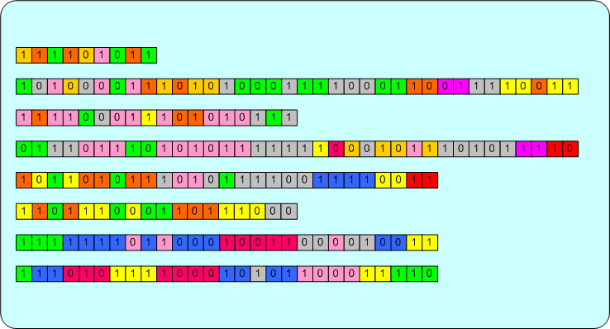
50th Generation
Best Chromosome

Slide 33
Question?

